Slide 1



TPO & Customer Targeting Recommendation
Data & Analytic, D&T
Votana SREY, Data Steward

Slide 2

CONTENT OF TODAY
HEINEKEN OpCo BASIC INFO
1
2
PROJECT INTRODUCTION
STATE OF THE ART
3
ANALYSIS & GENERAL CONCEPT
4
CONCLUSION
5
2

Slide 3

PROJECT INTRODUCTION
Trade Program Optimization & Customer Targeting Recommendation

Slide 4










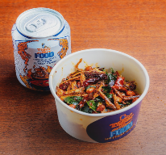
HEINEKEN Trade Program Marketing Running

Slide 5
Long Process & Alignment to Proceed the Trade Marketing Plan
Problem & Issue

Slide 6
OBJECTIVES
To finetune customer targeting in order to leverage the effectiveness of the trade term program. To apply analytics model in order to uncover any hidden gaps in master data and trade term is the selected case for this study. Thus Data & Analytic Team has come up an idea to assist TM to solve this out to increase the sell volume and company KPI as well. The objectives would be:
Improve the trade program targeting effectively
Increase the sell volume and profit generate by trade program optimization model
Understand the customer’s performance & behaviors
Improve the master data and data model & what the need to push master data help the trade program targeting.

Slide 7

HYPOTHESIS AND RESEARCH QUESTIONS

Slide 8
HYPOTHESIS & RQ
To apply analytics model in order to uncover any hidden gaps in master data and trade term is the selected case for this study. We are currently having the hypothesis to test it out:
Null Hypothesis (H0): Improving the trade program and customer targeting will NOT increase the sale volume and profit of revenue company KPI.
Alternative Hypothesis (H1/HA): Improving the trade program and customer targeting will increase the sale volume and profit of revenue company KPI.
Research Questions
What’s the current process of doing trade program targeting?
What are the metrics to analyze on trade program performance and correlation between customer targeting?
​How can master data maintain to support the trade program targeting?
Which is the best model to implement with customer targeting recommendation for trade marketing?

Slide 9

METHODOLOGY

Slide 10




METHODOLOGY
In this part, we are going to extract the data from the data warehouse of outlet transaction data to see the performance and we are going to explore the data in order to gain more insights from the data and also the trade marketing insight analysis as well.
Trade Program Performance Analysis
Customer Performance Analysis
Customer Behavior Analysis
Customer Segmentation
Trade Marketing
Sale Operation
Route to Consumer
Route to Consumer

Slide 11
METHODOLOGY
Advance Analytic on the model to recommend the customer targeting effectively
Historical Customer, Trade Program Data
Promotion Price & Budget
Trend-Estimation Algorithm
Adaptive-Greedy Algorithm
Customer Performance, Segementation
Customer Targeting Recommendation

Slide 12
PROJECT ROADMAP & PLANNING

Slide 13
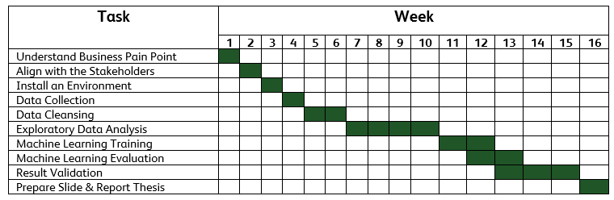
PROJECT ROADMAP
Current Process
Next Process
Understand the gaps of current scope both business and data
Propose recommendation to business on the targeting gaps
Propose recommendation to Data Team for a better data strategy that can fill the gaps
Customer Persona and other master data information to be collected and maintained
Support “lead digital and ecommerce” ambition
Current scope: understand the current status first
Post the ideal scenarios, what should be the best way in optimizing the program
Data Warehousing (DM) Data Model (DM) Analytics Model (DA)
Forward looking into what are the new fields (new info), how the fields are needed, what will be of use, how to leverage on them
Think outside the box, this is an exploratory study. What are the data we should further collect, maintain, how these data will be beneficial, what are the new insights it will bring
1
2
3
4
PROJECT PLANNING
The project has 4 months in duration. That’s starting from 15 January 2023 to 15 May 2023. This table below illustrate the project planning and listing the tasks from A to Z.

Slide 14
DATA COLLECTION

Slide 15







DATA COLLECTION
Data Source / Source System
Data Integration
Data Warehouse
SSIS
ETL
DWH_HCAM
Flat file
SEM
DOT (Tich Tos)
Base JDE
Staging
Server
OutletMasterSEM
Dynamics NAV 2015 (DIS)
Staging
Archive
DIS

Slide 16






DATA COLLECTION
Data Source / Source System
ETL Tool (Optional)
SSIS or Azure Factory
Flat file
SEM
Power BI
DOT (Tich Tos)
Base JDE
Staging Server
DWH Server
Users
Excel
Dynamics NAV 2015 (DIS)
Staging_Archive
OLAP Cube

Slide 17
DATA COLLECTION
Demand Forecasting
TradeCensus, Market Survey
Other Relevant Data
Sell Out
Agent, DIS
Inventory Mgt
GlassRun
Order Mgt
B2B
Commercial Data
TPO & Customer Targeting
Sale Data
Promotion, DOT
Market Share
Master Data
Sell In
Financial Data, Base JDE
POSM
SEM
Order Received, DIS
Vendor, Mendix
Customer Data
Item Data
Agent Data
Customer Data
PICOS
Asset
Activation

Slide 18
DATA COLLECTION
Demand Forecasting
TradeCensus, Market Survey
Other Relevant Data
Sell Out
Agent, DIS
Inventory Mgt
GlassRun
Order Mgt
B2B
Commercial Data
TPO & Customer Targeting
Sale Data
Promotion, DOT
Market Share
Master Data
Sell In
Financial Data, Base JDE
POSM
SEM
Order Received, DIS
Vendor, Mendix
Customer Data
Item Data
Agent Data
Customer Data
PICOS
Asset
Activation

Slide 19
DATA COLLECTION
Total Outlet Sample (Unique)
1500
Est. Order Transactional Data
2500
Total Features
45
List the Features
Agent_Code
Agent_Name
Outlet_Code
Customer_Name
OutletNameKh
OutletNameEn
Region
Province
Account_Type
City
District
Commune
Village
Segment
Business_Org_Segment
Business_Segment
Category
ChannelName
OutletCreditStatus
AMS_HCAM_Premium_Brand
AMS_HCAM_Mainstream_Brand
AMS_Competitors_Premium_Brand
AMS_Competitors_Mainstream_Brand
OrderType
Document No_
DocType
ContractType
OrderCategory
ItemCode
Quantity
HL
amount1
Amount Including VAT
itm_code
itm_des
level1_territory and Name
level2_territory and Name
level3_territory and Name
level4_territory and Name
Order Date
Posting Date
Posting Description
Shipment Date
Due Date
Document Date

Slide 20
POWER BI Dashboard
Trade Program Performance Analysis

Slide 21


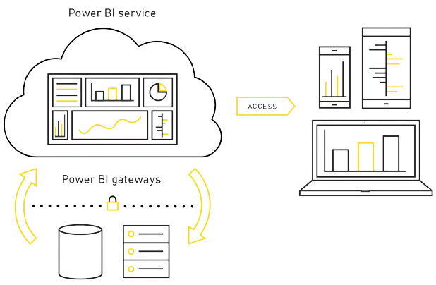
DASHBOARD ARCHITECTURE
Data Source
ETL Tool (Optional)
SSIS or Azure Factory
Dashboard Development
Machine Learning Model Deployed
Flat file
SEM
DIS
Staging Server
DWH Server
PBI Desktop
DOT
(Tinh Tos)
Used to secure data transfer between
on-premises data
User Access
PBI Service
PBI Gateways

Slide 22
TECHNOLOGY

Slide 23
















TECHNOLOGY
LANGAUGES
TOOLS
Python
SQL
DAX
MS SQL Server
Anaconda
VS Code
MS PowerBI
MS 365
LIBRARIES
FRAMEWORKS
SKLearn
Matplotlib
Seaborn

Slide 24
This is the title for the cover
Name presenter

